Slide 1
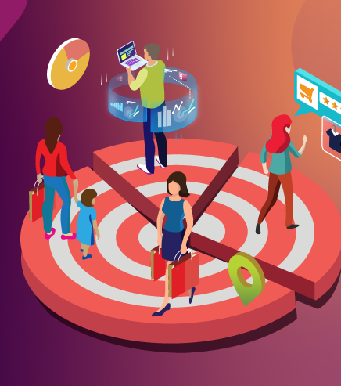
CUSTOMER SEGMENTATION ANALYSIS
- By INDRANEEL DAS

Slide 2
INTRO
Customer Segmentation is a key technique used to understand different types of customers based on their characteristics and behavior. This project analyses customer data using age, income ,and spending score to identify meaningful pattern. Using IBM Cognos Customers Analytics, both a dashboard and report are created to visualize insights and support better business decision-making

Slide 3
Data Description
The dataset contains information about customers, including their demographic and financial details. The key variables used in this analysis are customer id, age, income and spending score . This variables helps in understanding the customer pattern and segmenting them effectively.

Slide 4
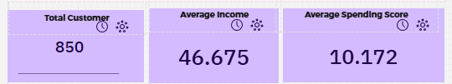
KPI’s
KPI(key performance indicator) is a data visualization used to track progress towards a specific goal or target.
Here,
The first KPI shows the “total number” of customers.
The second KPI shows the “average income” of all the customers.
The third KPI shows the “average spending” score of all the customers.

Slide 5
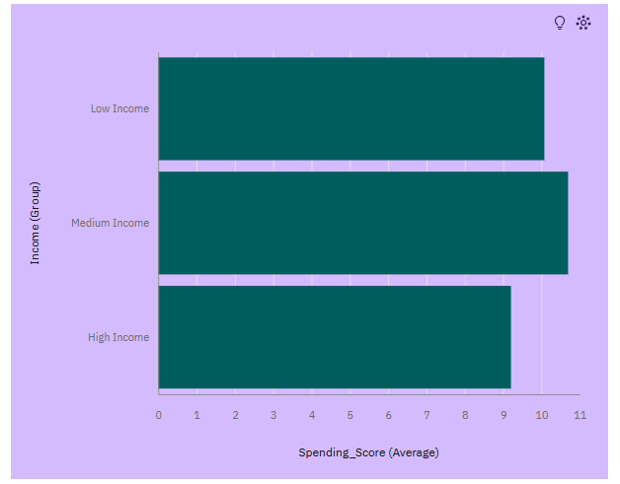
BAR CHART
It shows the comparison of average spending across different income groups.
It helps identify which income category spends more

Slide 6
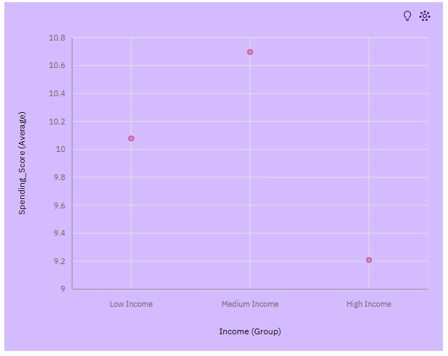
SCATTER PLOT
It displays the relationship between the income group and spending score . It also helps to visualize the customers segments and identify the spending patterns .
Visualizes customer segmentation by showing how income related to spending behavior
6

Slide 7
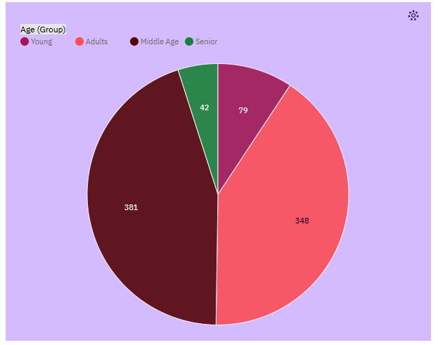
PIE CHART
The pie chart represents the distribution of customers across the different age groups. It shows which age group has the highest number of customers .
Shows the proportion of customers in each age group
7

Slide 8

FILTERS
Filters allow the users to interact with the dashboard by selecting specific groups such as age , income , or spending , making the analysis more dynamic and focused .
Enables interactive analysis by allowing users to views specific segments of data
8

Slide 9
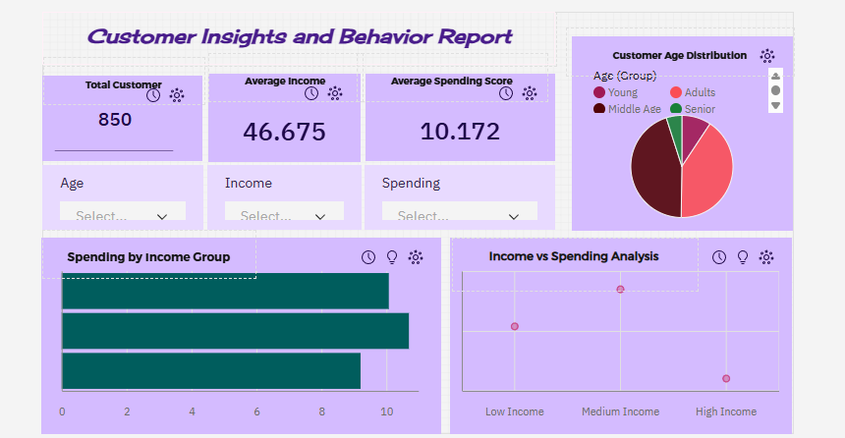
DASHBOARD OVERVIEW

Slide 10
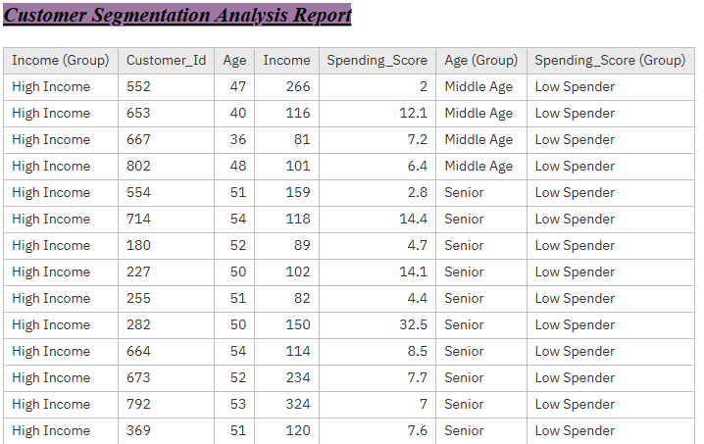
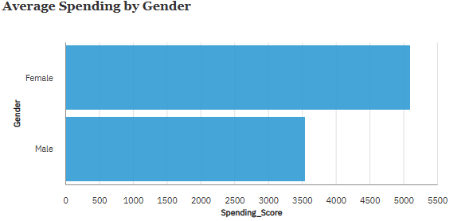
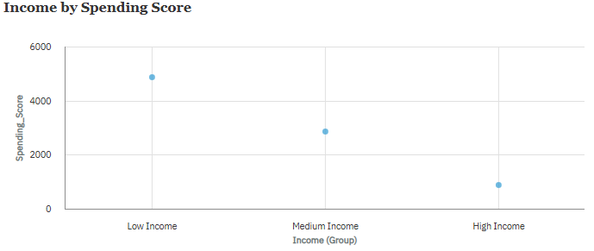
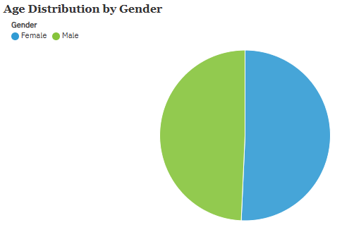

Slide 11
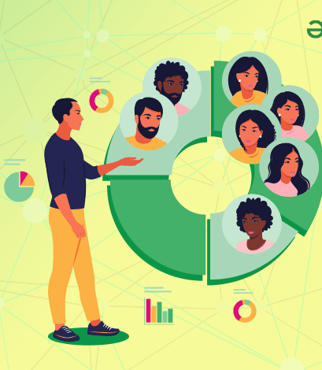
CONCLUSION
This project highlights the importance of the customer segmentation in understanding behavior and improving business strategies.
Using IBM Cognos Analytics, both dashboard and report provide valuable insights for better decision-making .

Slide 12
Thank you

